Slide 1

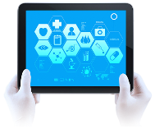
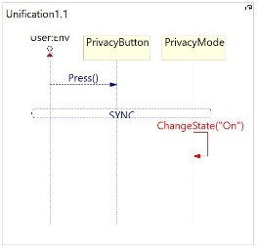
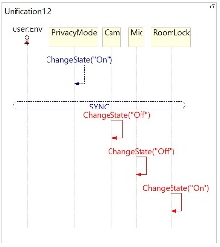
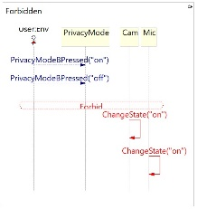
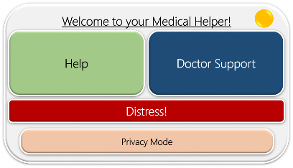
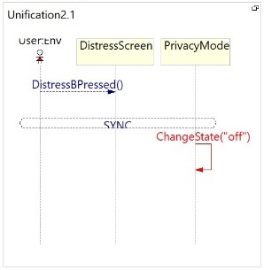
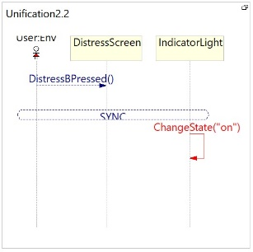

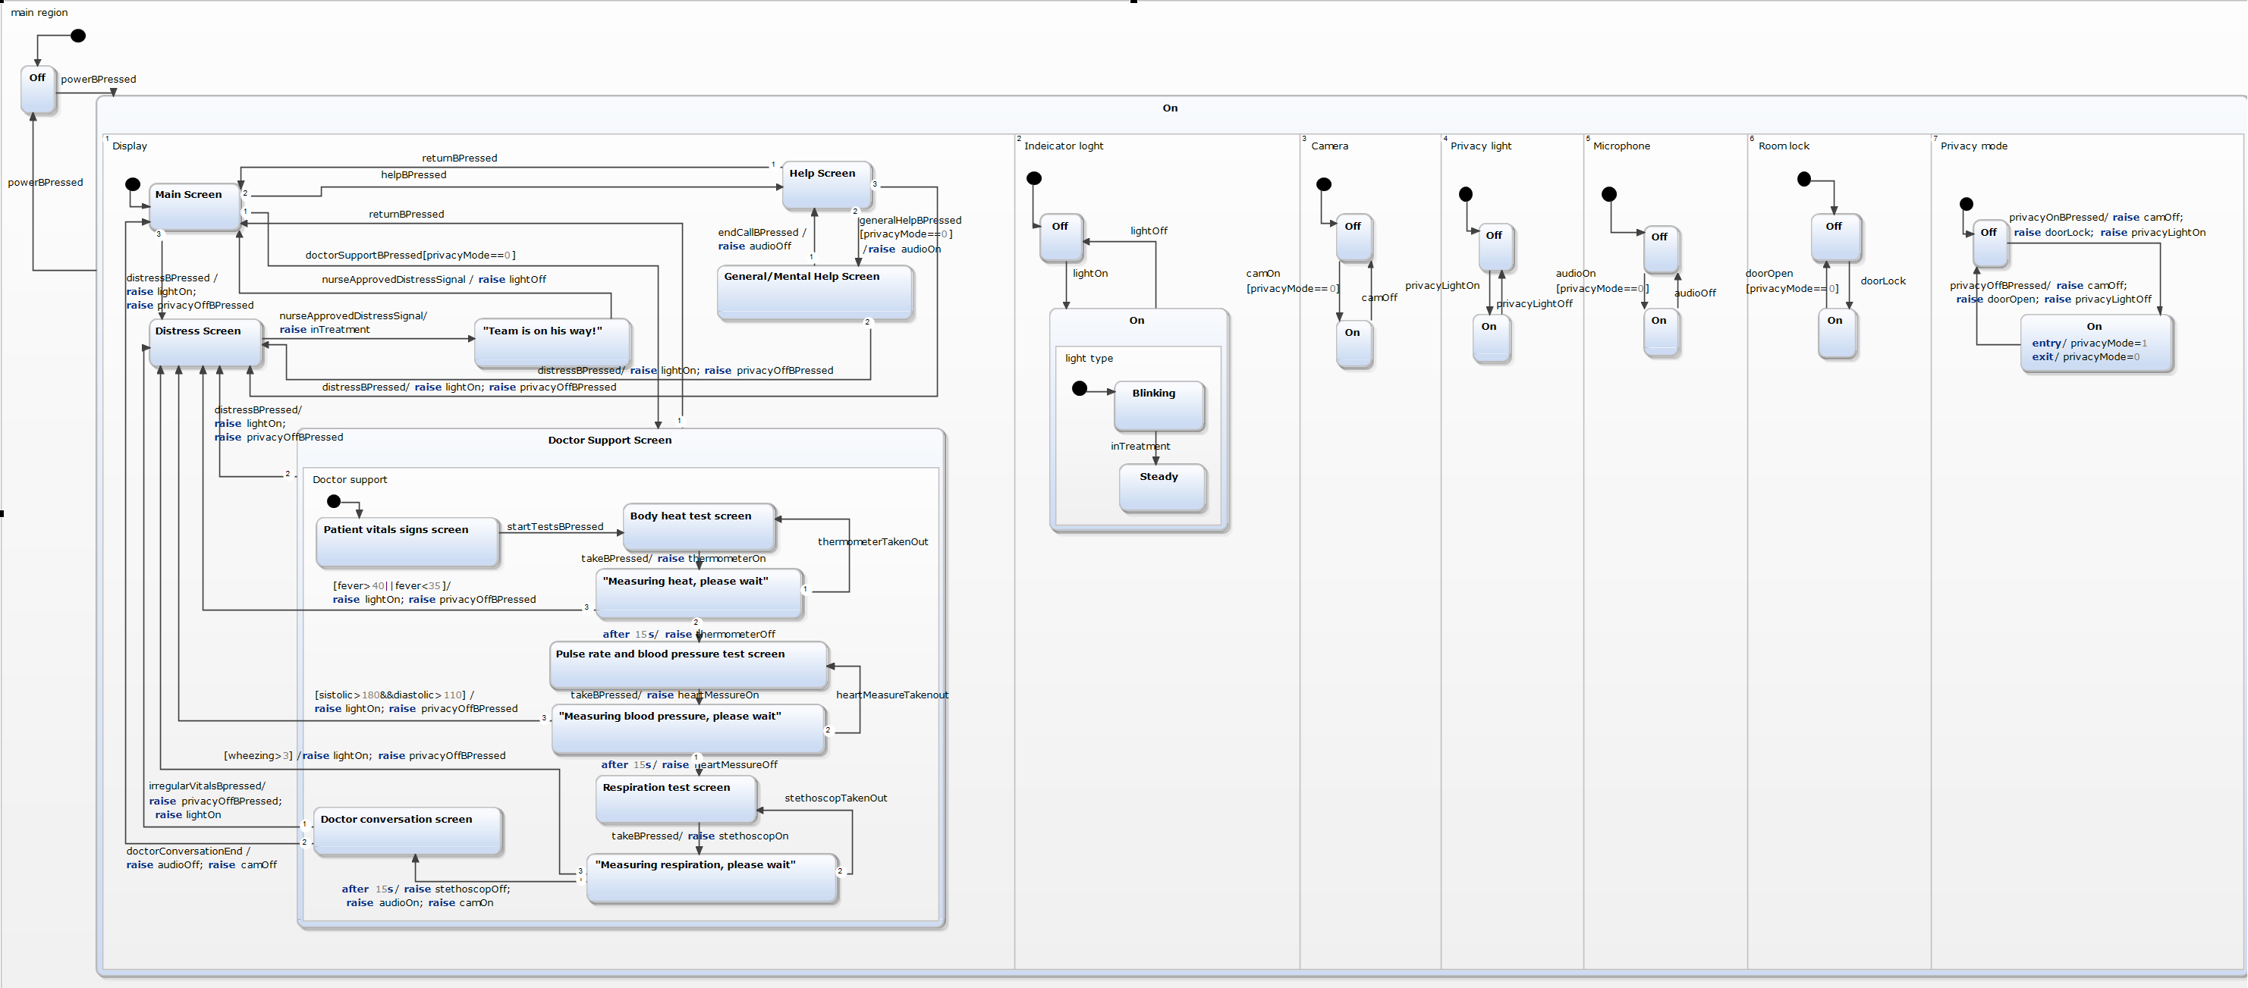

Medical helper at Corona times
קורס תכנות ויזואלי למערכות ריאקטיביות (65347)
סמסטר ב', תש"פ מרצה: ד"ר מיכל גורדון מגישים: עדי גולדרייך ויובל ניר, מדעי המחשב
Project Description
LSC
The system we created, is inspired by the complicated time we’re experiencing, it will be used to help Corona’s hospitalized people communicating with their doctors and support teams.
The system will be used at isolated rooms in hospitals\ Corona hotels to avoid contagion, and will help its users to communicate with the outer world.
While creating the LSC for our project we defined our primary demands and then used PlayGo to create them as diagrams.
We created 5 regular diagrams, 2 unifications and 1 forbidden diagram.
Unification 1: Forbidden
Unification 2:
Inputs & Outputs
The system’s inputs are the pressings of the user on the system’s buttons which create system reactions. The system acts according to the user’s choices and provides him what he\she needs. Another kind of the system’s inputs are the variants which represent the users vital signs.
Therefor, the system’s outputs
are the services the user gets
to provide him\her the support
– the general support, the
doctor support and the distress
area which provides life-saving
services.
Reactive Examples in the System
The system is directed by the user to it’s different states, according to the user’s answers\ button pressing.
For example, in the beginning the user needs to choose which part of the system he\she would like to use. Afterwards, if the user chose “Doctor support” for example, the system would act according to his medical tests and preferences. The system has a lot of different states that are affected by the variety of user’s decisions.
Modeling Challenges
Statecharts
Both LSC and Statecharts allowed us to model our system quite effectively, while dealing with each language challenges.
The main behavior we had trouble expressing in both languages was the privacy mode and how to create all it’s guards and limitations in an efficient way. We overcame this difficulty by creating privacy variable in statecharts, that is not available in LSC, and using forbidden (as seen in page 26) to define the privacy limitations.
Part of modeling that wasn’t expressed enough in statecharts were the components like thermometer, stethoscope and more that had only on-off states. These components were mentioned in the transitions as part of broadcasting but don’t show in the diagram in order to keep it simple and clear.
There are a lot of features that can be
added to the system along the way,
but we believe it is built in a modularly
way so any addition will be quite easy
to handle.
The system consists of several parts like display, camera, microphone, indicators and others, which act in parallel and shows the orthogonality of the system.
Each of these parts contains states that illustrates the system’s reactions, starting from on\off and drilling down to any button pressed by the user and how it affects the other system parts.
The main part of the system is the Display which leads most of the system’s performances, and it’s transitions create the effects on the other states.
The display part consists 3 different services that the system offers: the general/ mental help area, the distress area and the doctor support area.
The other components of the system – the lights, microphone, camera, locks and privacy mode, are mostly triggered to act according to the display part. A lot of transitions in the display section have effects that create these components reactions.
Summary
This project was very interesting
for us and exposed us to a whole
new content we’ve never met before.
We believe that this course’s content
is very important for each student in
the Hi-tech world to know, in order to
create a more visualized and efficient way
of thinking and working.
github
קישור ל בו נמצאים הקוד,
סרטון המקור וסרטון הצגת הפרויקט

